Slide 1
Viola Jones algorithm
Seitzhanova Altyn

Slide 2
The training of classifiers is very slow, but the results of the face search are very fast, which is why this method of face recognition in the image was chosen. Viola-Jones is one of the best in terms of recognition efficiency/speed. This detector also has an extremely low probability of false face detection. The algorithm even works well and recognizes facial features at a slight angle, up to about 30 degrees. When the angle of inclination is more than 30 degrees, the percentage of detections drops sharply. And this makes it impossible in the standard implementation to detect a person's turned face at an arbitrary angle, which greatly complicates or makes it impossible to use the algorithm in modern production systems, taking into account their growing needs.
Viola jones algorithm

Slide 3
The basic principles on which the method is based are as follows:
images are used in an integral representation, which allows you to quickly calculate the necessary objects.;
Haar features are used to search for the desired object (in this context, a face and its features).;
Boosting is used to select the most appropriate features for the desired object in a given part of the image.;
all signs are received at the input of the classifier, which gives the result "true" or "false";
Cascades of features are used to quickly discard windows where no face has been found.

Slide 4
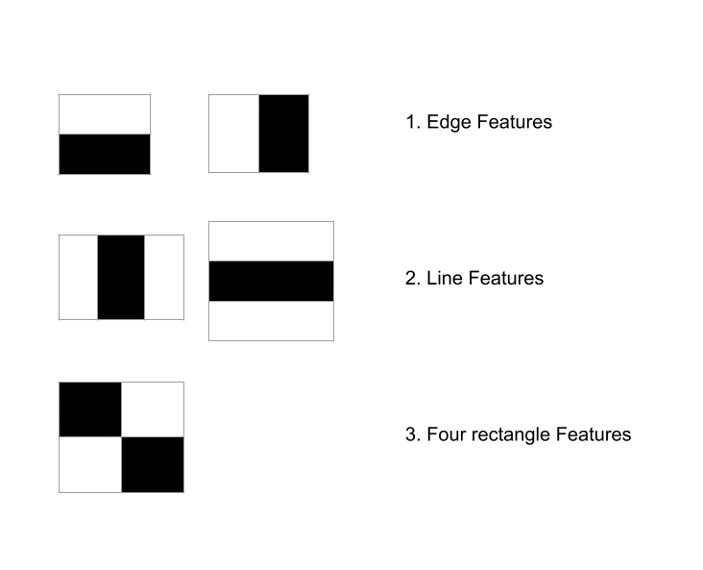
Haar features are the relevant features for face detection. It was proposed by Alfred Haar in 1909. They are like convolutional kernels. There are various types of haar like features but the most dominant features used are :
2 Rectangular Haar features
3 Rectangular Haar features
4 Rectangular Haar features

Slide 5
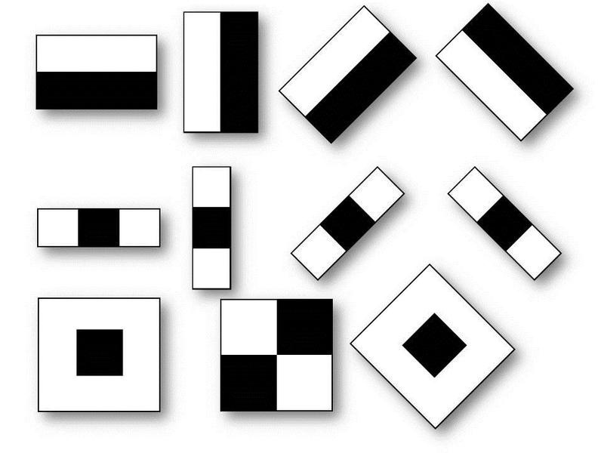
Haar features
Adjacent rectangular regions at a specific location
Sums up the pixel intensities in each region
Calculate the difference between these sums

Slide 6
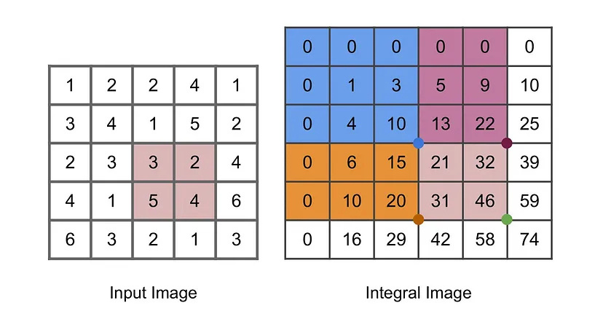
Integral image
Because we have to use haar-like features in all possible sizes and locations which eventually result in around 200k features to calculate which is a really big number. The problem with novel calculation of haar features is that we have to calculate the average of a given region multiple times and the time complexity of these operations are O(n*n). We can use an integral image approach to achieve O(1) running time. A given pixel in the integral image is the sum of all the pixels on the left and all the pixels above it.

Slide 7
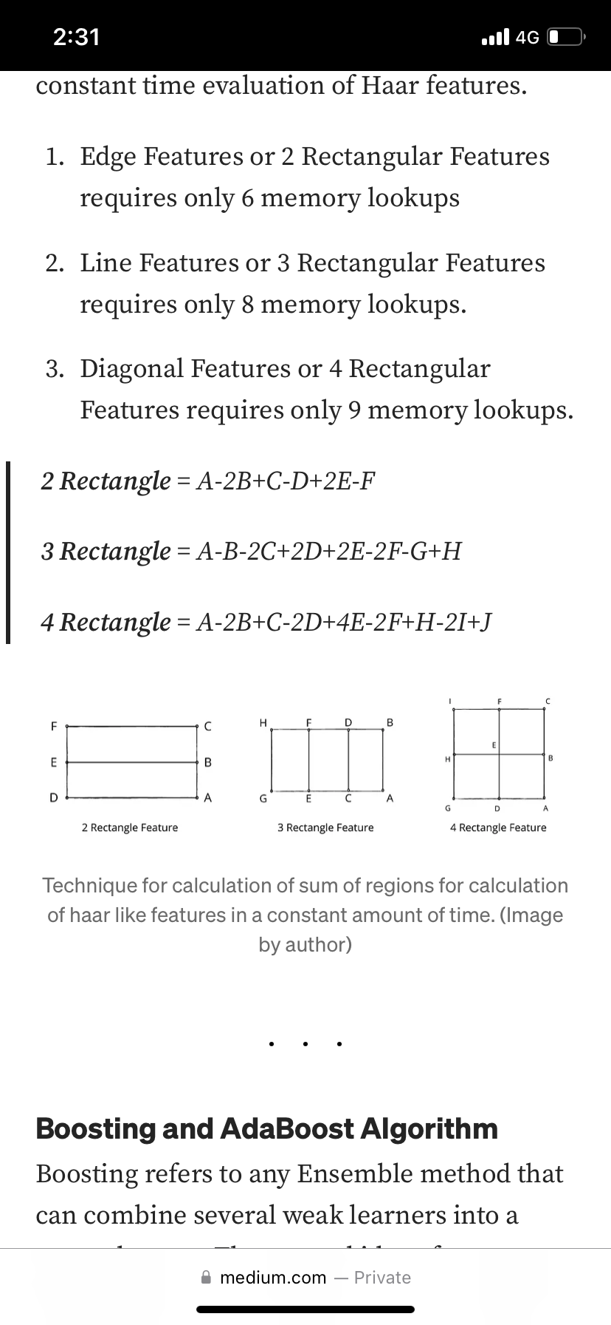
Using integral images we can achieve constant time evaluation of Haar features.
Edge Features or 2 Rectangular Features requires only 6 memory lookups
Line Features or 3 Rectangular Features requires only 8 memory lookups.
Diagonal Features or 4 Rectangular Features requires only 9 memory lookups.

Slide 8
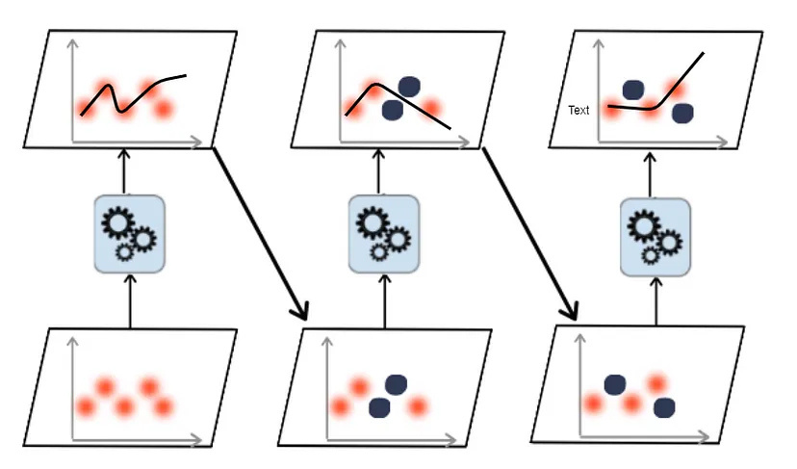
Ada boosting
Thynk Unlimited
1.Many Weak Classifiers: Instead of using one complex classifier, AdaBoost combines many simple ones. These simple classifiers (called “weak classifiers”) focus on detecting small patterns in an image, like edges or bright and dark areas.
2. Boosting: Initially, all weak classifiers are given equal importance. If a classifier makes mistakes, AdaBoost increases its weight, meaning it pays more attention to the mistakes in the next round.
3. Final Strong Classifier: After several ryounds of boosting, AdaBoost combines all weak classifiers into a single, strong classifier that can accurately detect faces.
AI Ethics

Slide 9
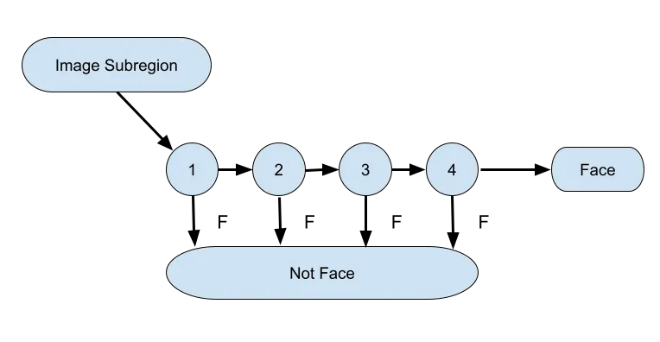
Cascade Filter
Strong features are formed into a binary classifier. : Positive matches are sent along to the next feature. Negative matches are rejected and exit computation.
Reduces the amount of computation time spent on false windows.
Threshold values might be adjusted to tune accuracy. Lower threshold yield higher detection rated and more false positives.
In simple terms, each feature acts as a binary classifier in a cascade filter. If an extracted feature from the image is passed through the classifier and it predicts that the image consists of that feature then it is passed on to the next classifier for next feature existence check otherwise it is discarded and next image is checked. This thereby decreases computation time as we have to check only some features in windows where the object is not present rather than checking all features.

Slide 10
References
https://medium.com/towards-data-science/viola-jones-algorithm-and-haar-cascade-classifier-ee3bfb19f7d8
https://habr.com/ru/articles/133826/

